Slide 1
Data flow testing

Slide 2
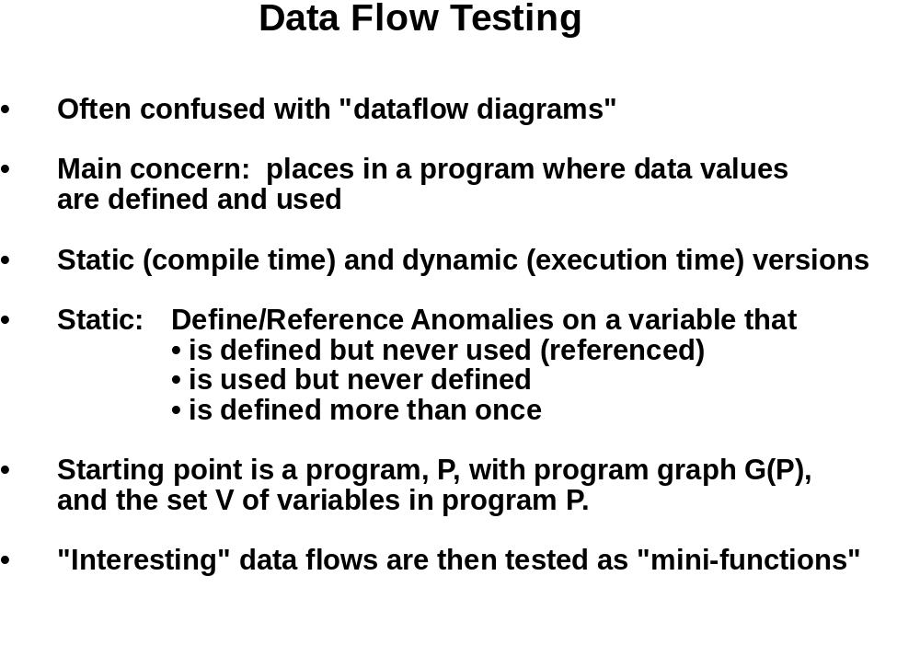

Slide 3
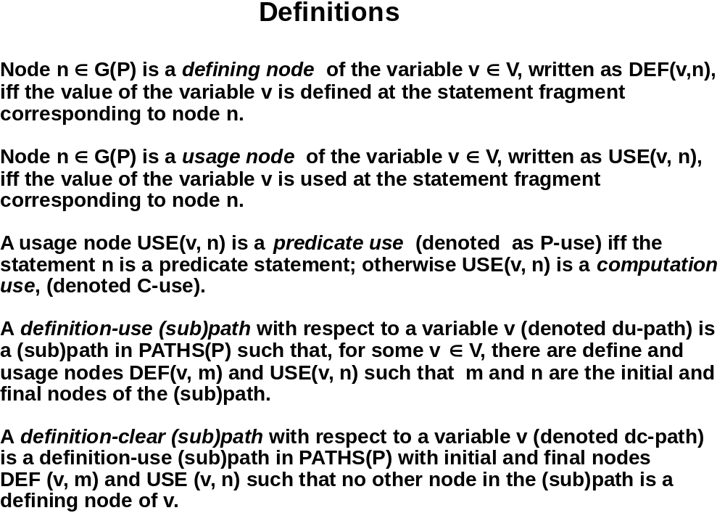

Slide 4
Some Definitions
Simple path is a path in which all nodes except possibly the first and the last are distinct
Loop free path is a path in which all nodes are distinct
Complete path is a path from the entry node to the exit node of the CFG
Du-Path with respect to variable x at node n₁ is a path [n₁, n₂, …. n_{k}] where n₁ has a global definition of x and either
  Node n_{k} has a global c-use of x and [n₁….n_{k}] is def-clear simple path with respect to x or,
  Node n_{k} has a p-use of x and [n₁….nj] is a def-clear loop-free path with respect to x

Slide 5
Defining Node
  Input statements
  Assignment statements
  Loop Control statements
  Procedure Calls
Use Node
  Output statements
  Assignment statements
  Conditional statements
  Loop Control statements
  Procedure calls
Predicate Use Out degree ≥ 2
Computation Use Out degree ≤ 1

Slide 6
Seven data flow testing criteria
  All-defs
  All-c-uses
  All-p-uses
  All-p-uses/some-c-uses
  All-c-uses/some-p-uses
  All-uses
  All-du-paths

Slide 7
Some more examples of DU
Def | C-use | P-use
x, y
z | x
 |  | z, y
w | x
y | y
 | x, y, w, z
1. read (x, y);
2. z = x + 2;
3. if (z < y)
4 w = x + 1;
else
5. y = y + 1;
6. print (x, y, w, z);

Slide 8
Define / Use Information Example
Variable | Defined at | Used at | Comment
locks | 9 |  | Declaration
locks | 22 |  | READ
locks |  | 23 | Predicate use
locks |  | 26 | Computation Use
stocks | 9 |  | READ
stocks |  | 27 | Computation Use
num_locks | 26 |  | Assignment
num_locks |  | 26 | Computation Use
num_locks |  | 33 | WRITE

Slide 9
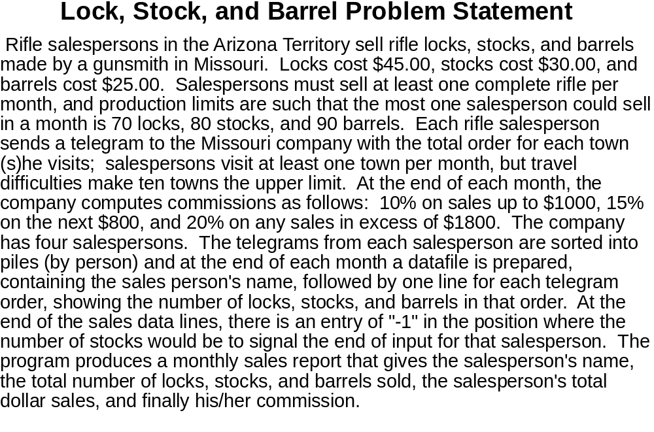

Slide 10
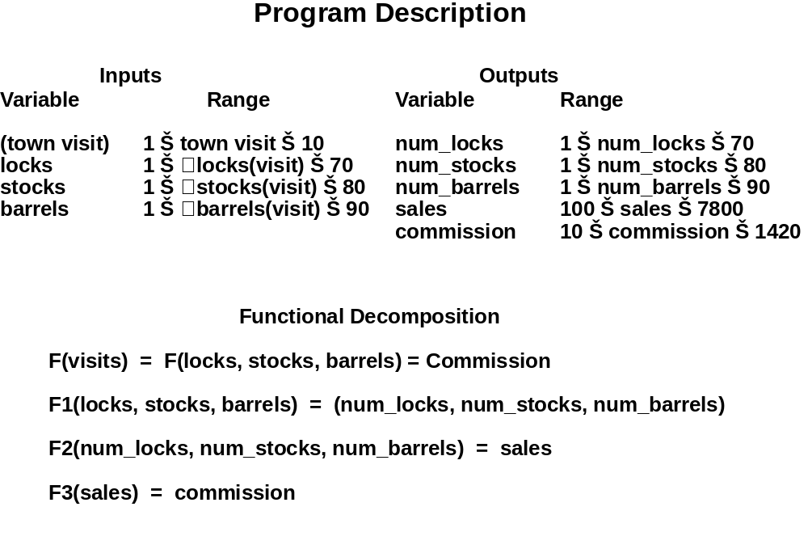

Slide 11
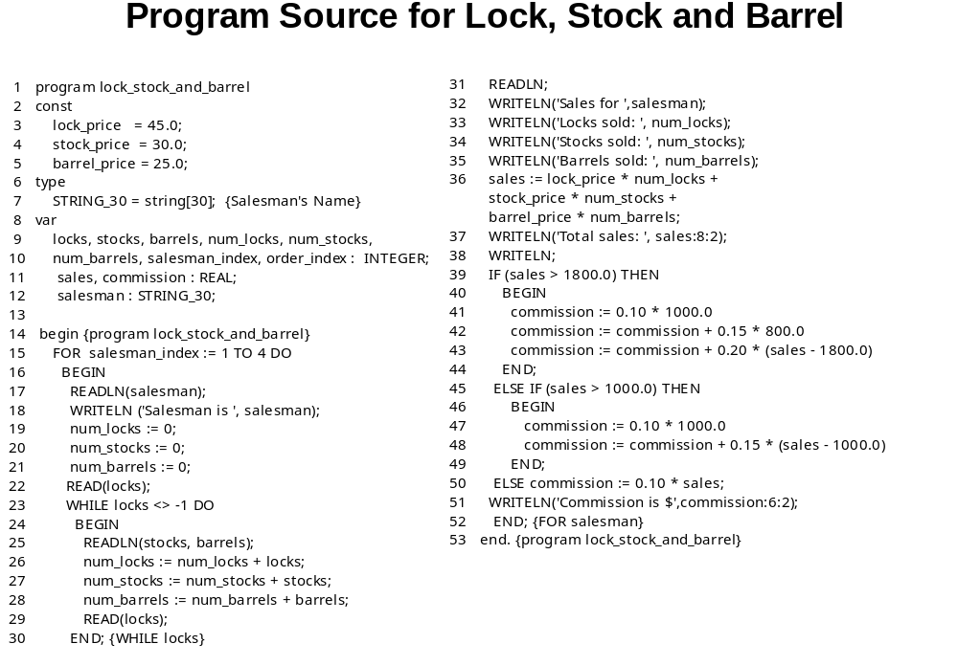

Slide 12
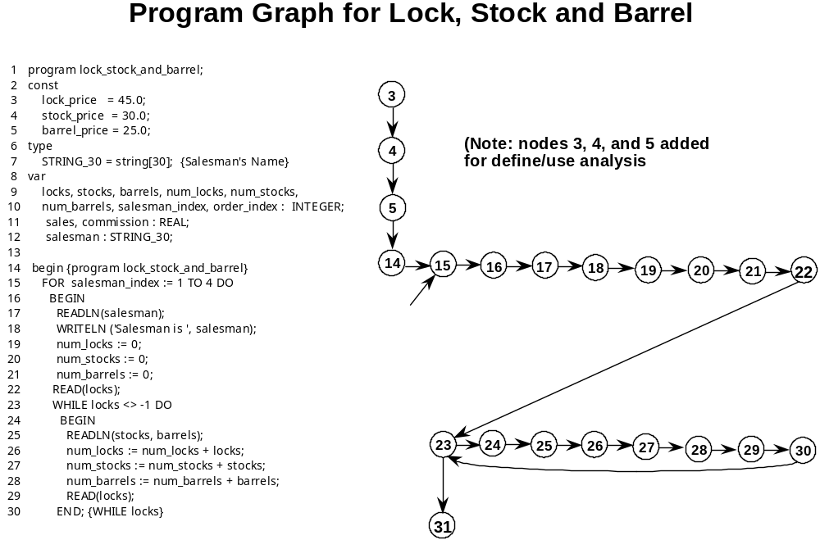

Slide 13
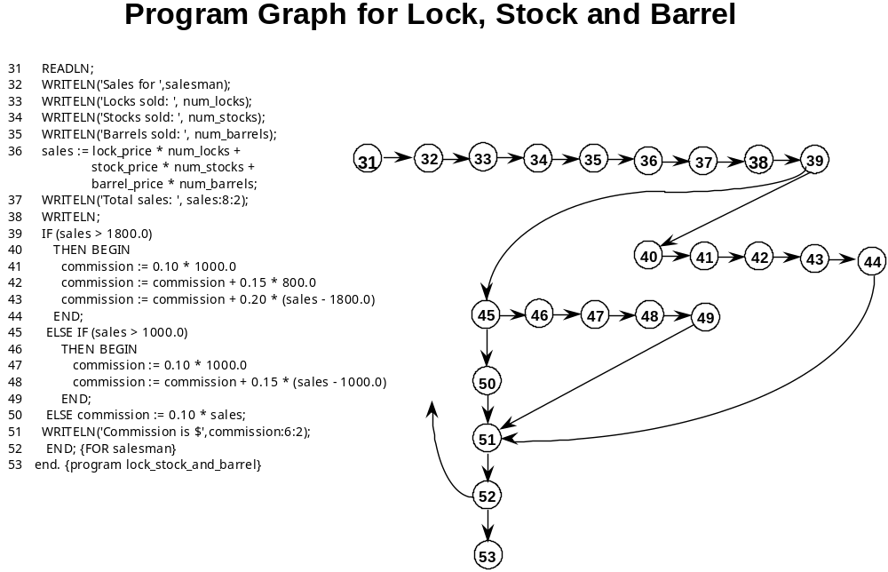

Slide 14
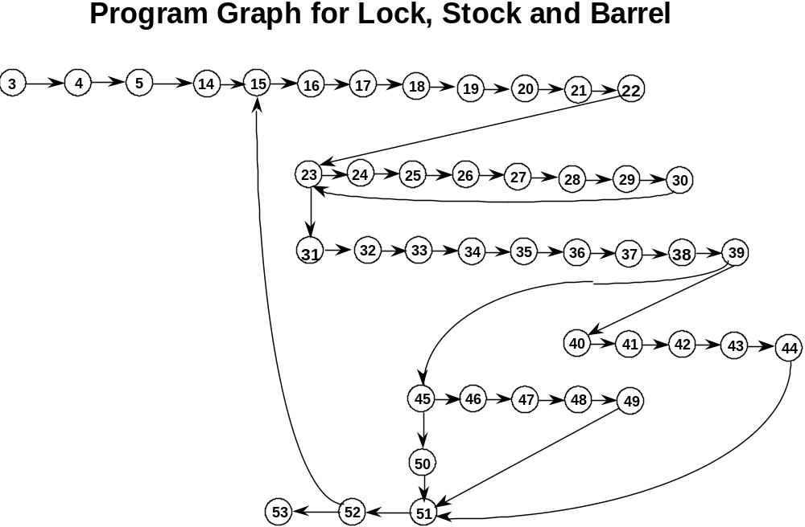

Slide 15
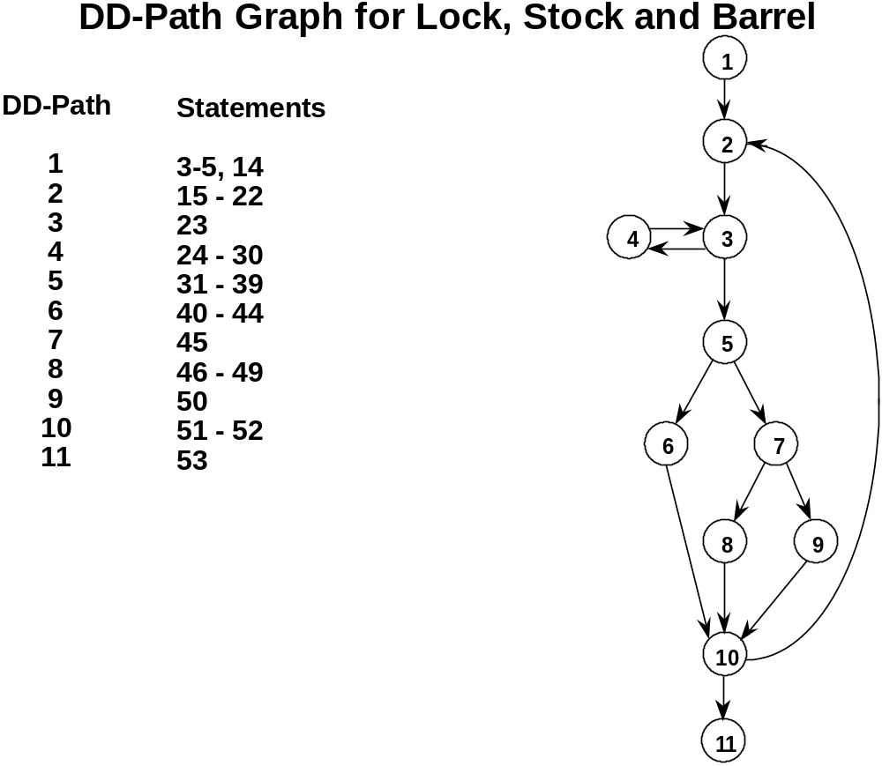

Slide 16
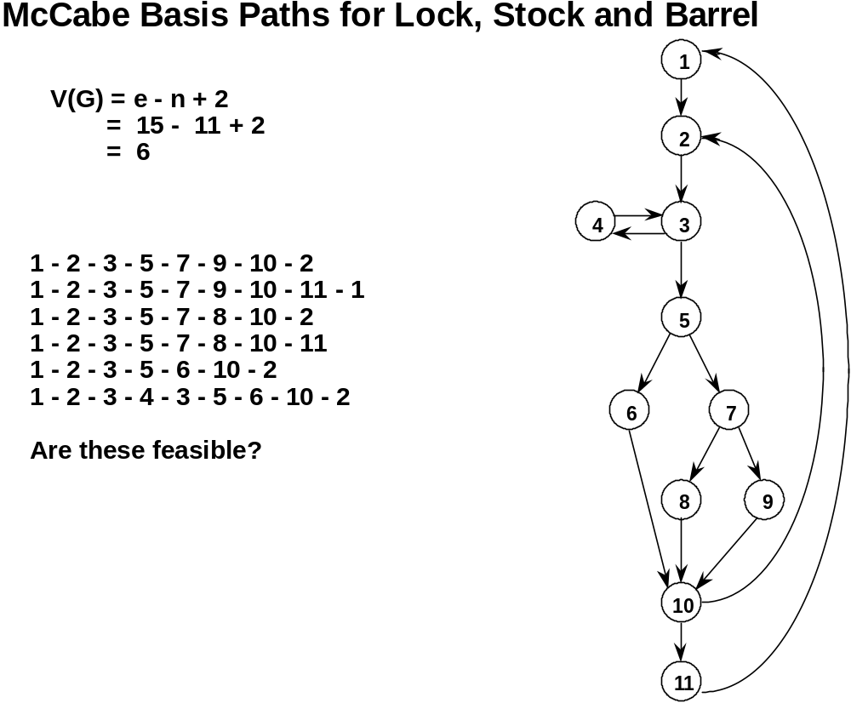

Slide 17
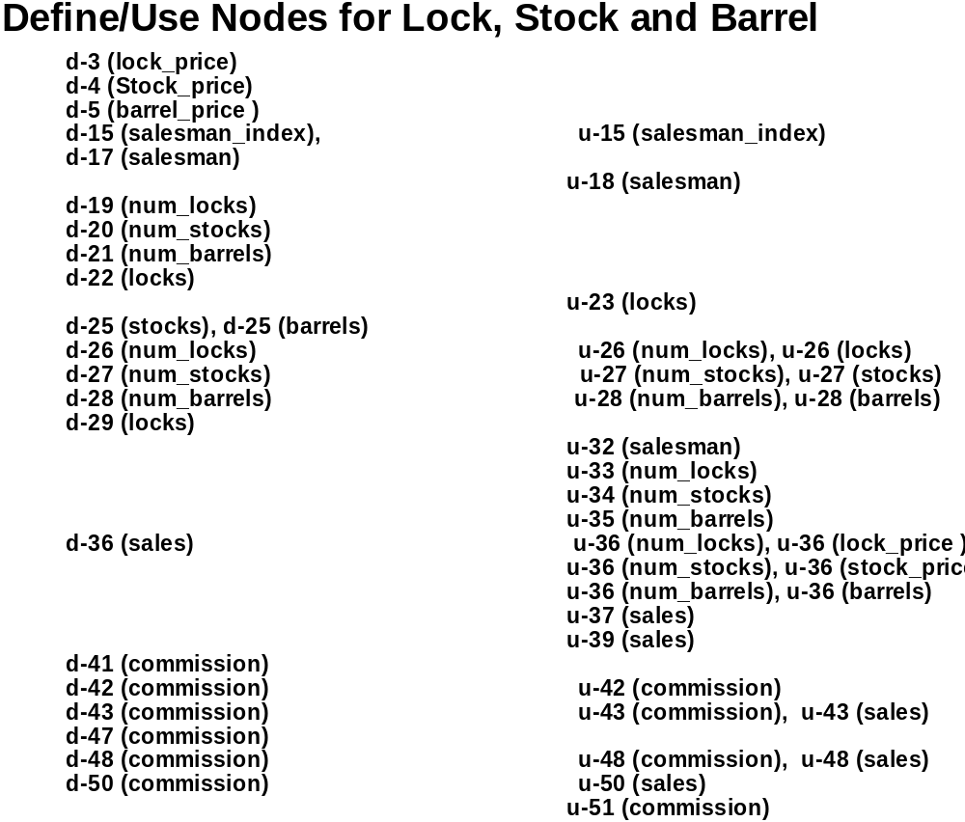

Slide 18
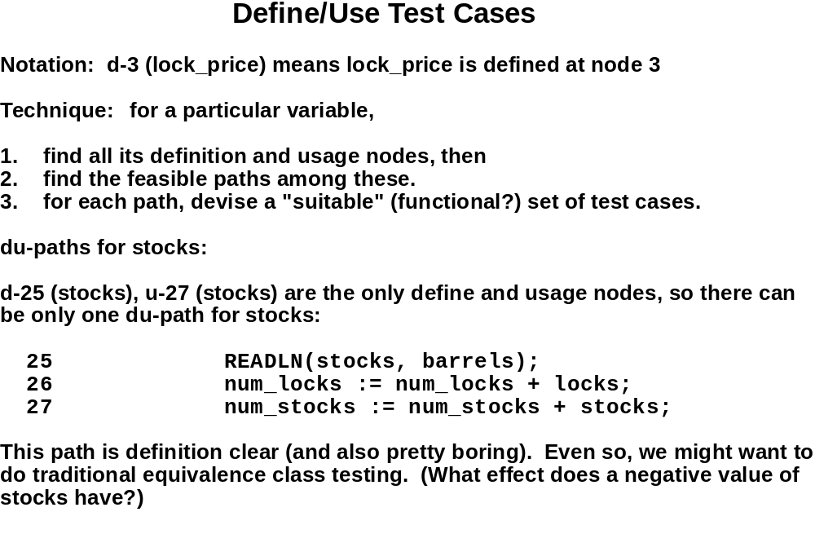

Slide 19
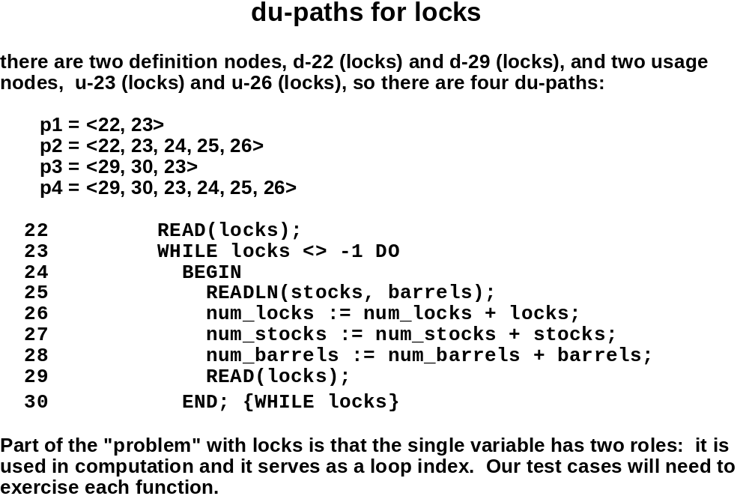

Slide 20
Define / Use Information Example
Variable | Defined at | Used at | Comment
locks | 9 |  | Declaration
locks | 22 |  | READ
locks |  | 23 | Predicate use
locks |  | 26 | Computation Use
stocks | 9 |  | READ
stocks |  | 27 | Computation Use
num_locks | 26 |  | Assignment
num_locks |  | 26 | Computation Use
num_locks |  | 33 | WRITE

Slide 21
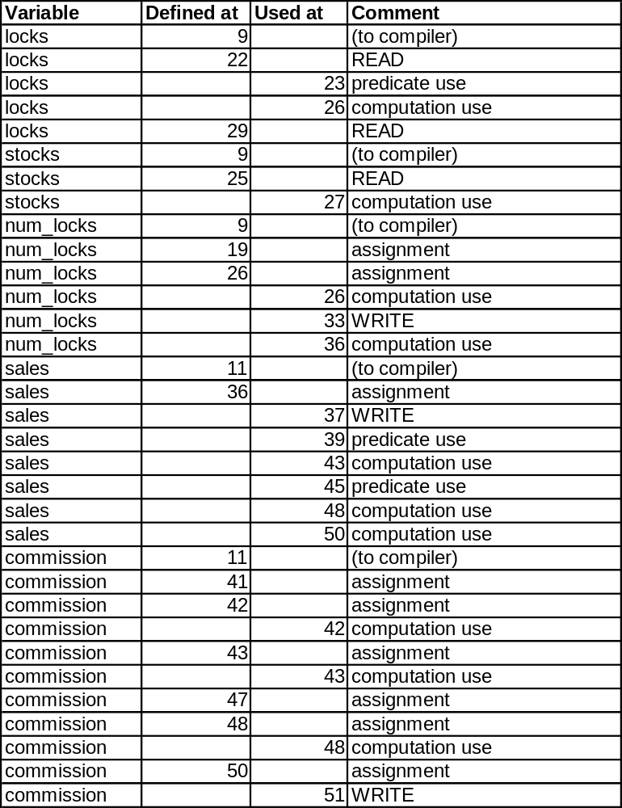

Slide 22
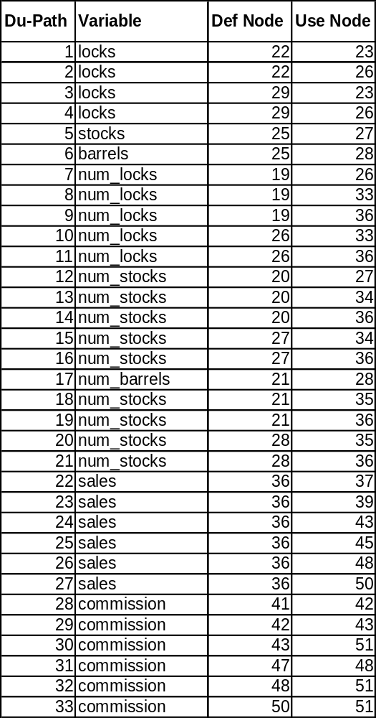

Slide 23
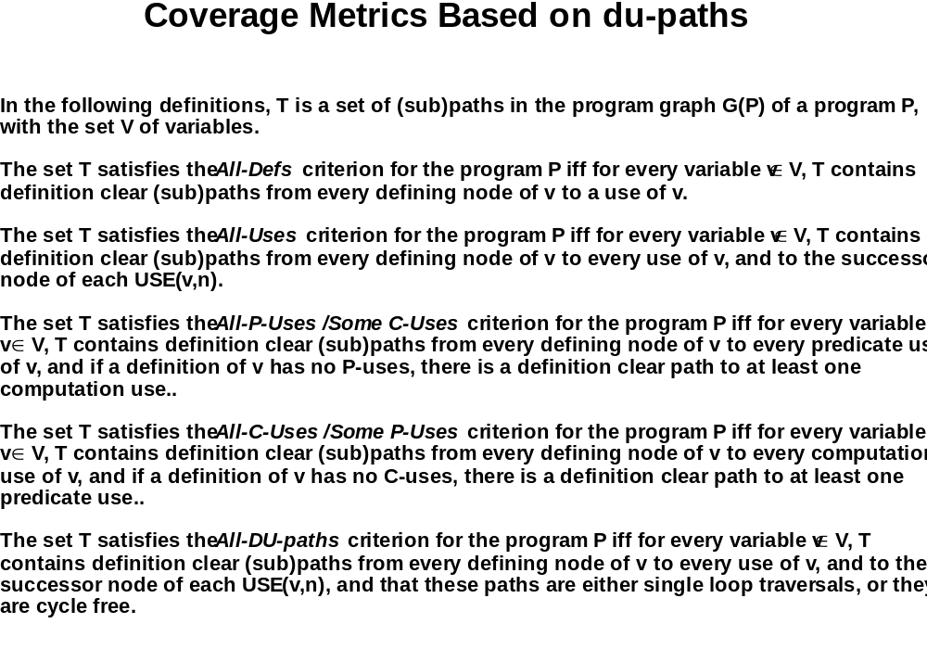
P-Use=Predicate use (in decision)
C-Use=Computation use

Slide 24

def 1(s)
def 2 (i)
use (i) --- loop
use (n) --- loop
def 4 (s)
use 4 (s)
use 4 (i)
def 5(i)
use 5 (i)
use 6(s)
use 7 (i)
use 8 (n)
1 s = 0;
2 i = 1;
3 while (i ≤ n)
{
4 s+ = i;
5 i++
}
6 Count << s;
7 Count << i;
8 Count << n;

Slide 25
Procedure SumEven
int n, sum, j;
1 sum = 0;
2 j= 2;
3 n = read ()
4 while (n> 0) do
5 sum = sum + j
6 j : = j + 1;
7 n: = n – 1;
Endwhile
8 Write (sum)
Slice for variable j as 6
Slices will be
Slice(2,3,4,6,7)
Slice for variable n where n is 7
Slice(3,4,7)

Slide 26
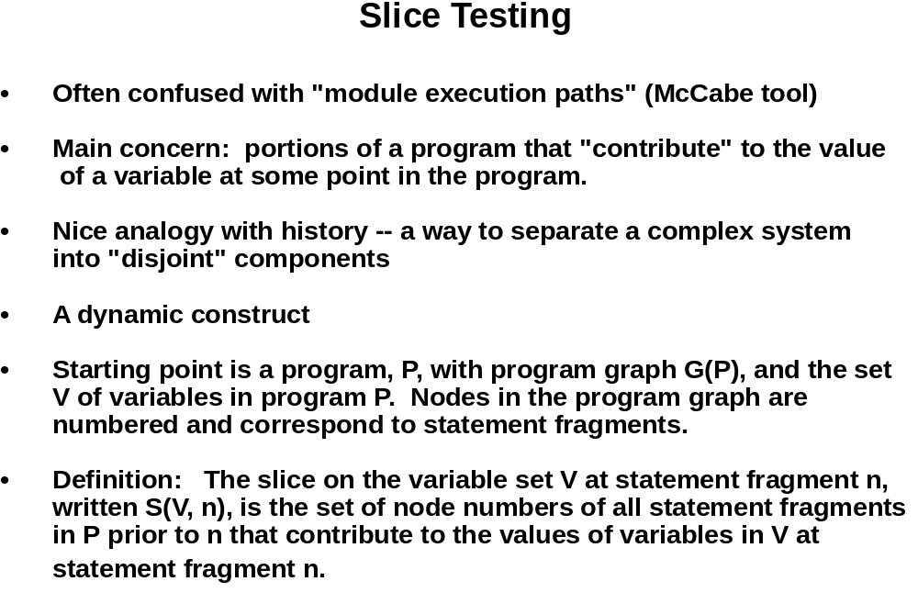

Slide 27
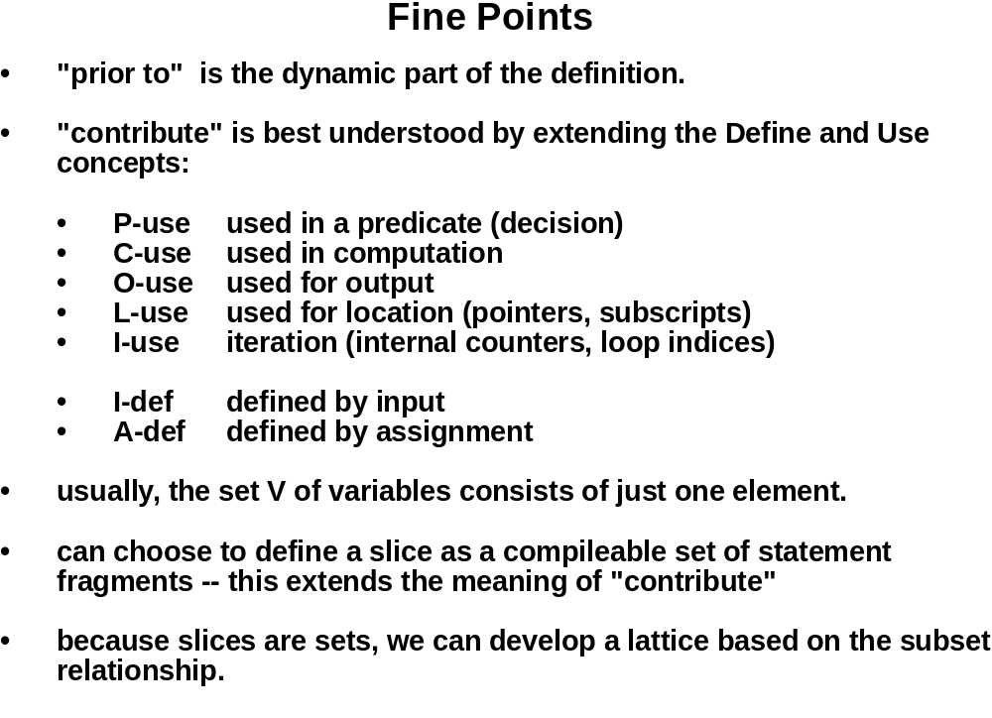

Slide 28
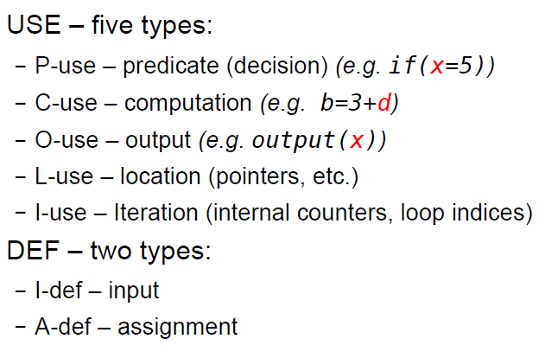
Fine points

Slide 29
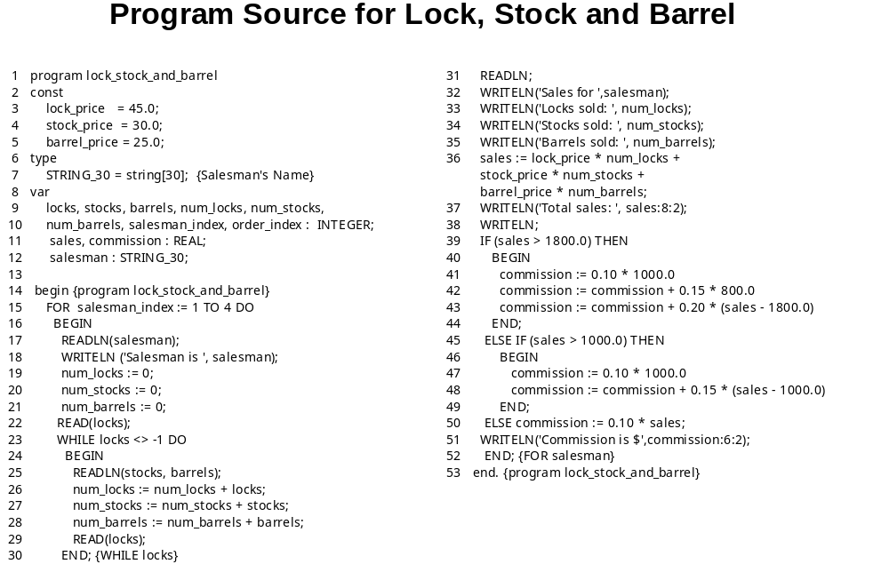

Slide 30
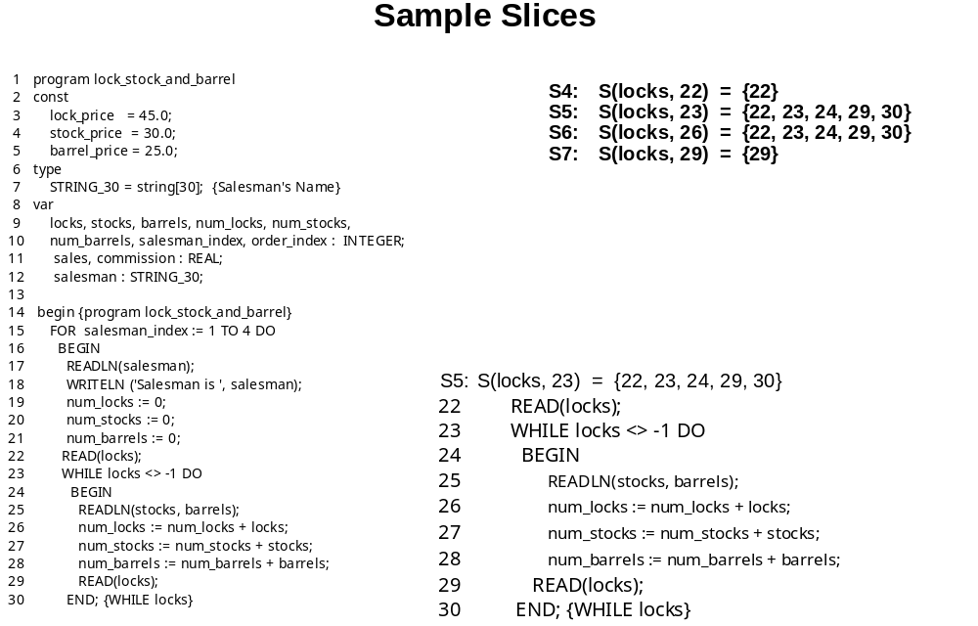
P-use at node 23 and a C-use at node 26, and has two definitions,
the I-defs at nodes 22 and 29.

Slide 31
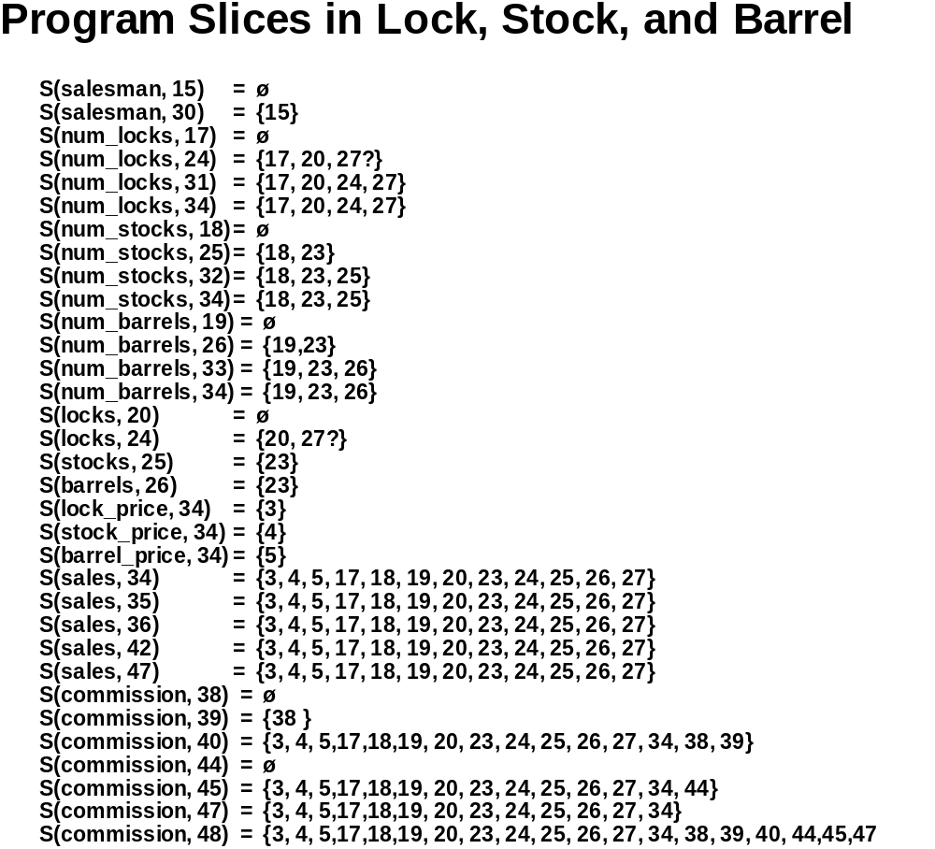

Slide 32
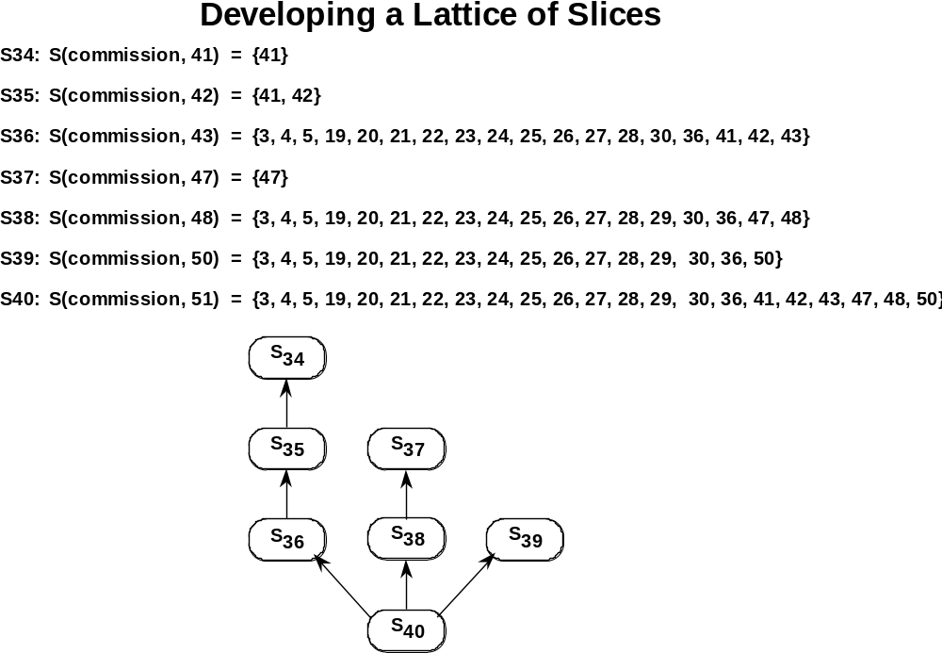

Slide 33
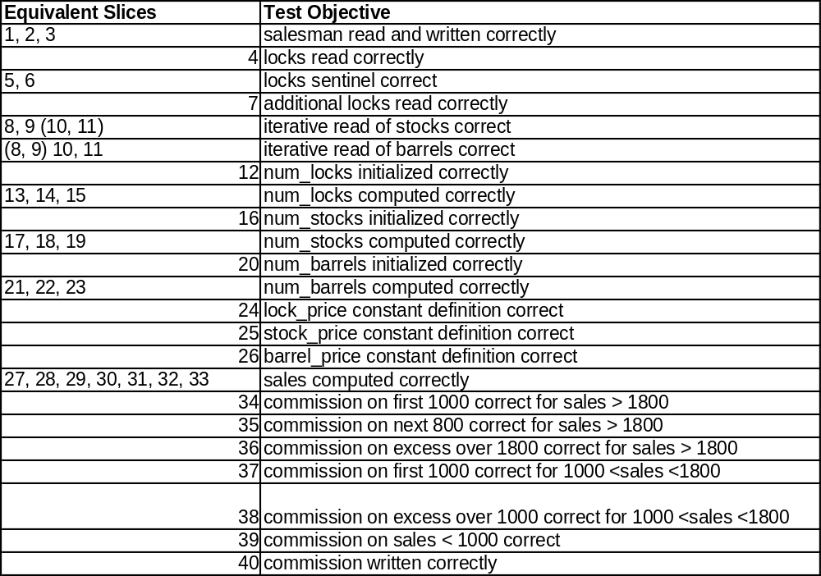

Slide 34
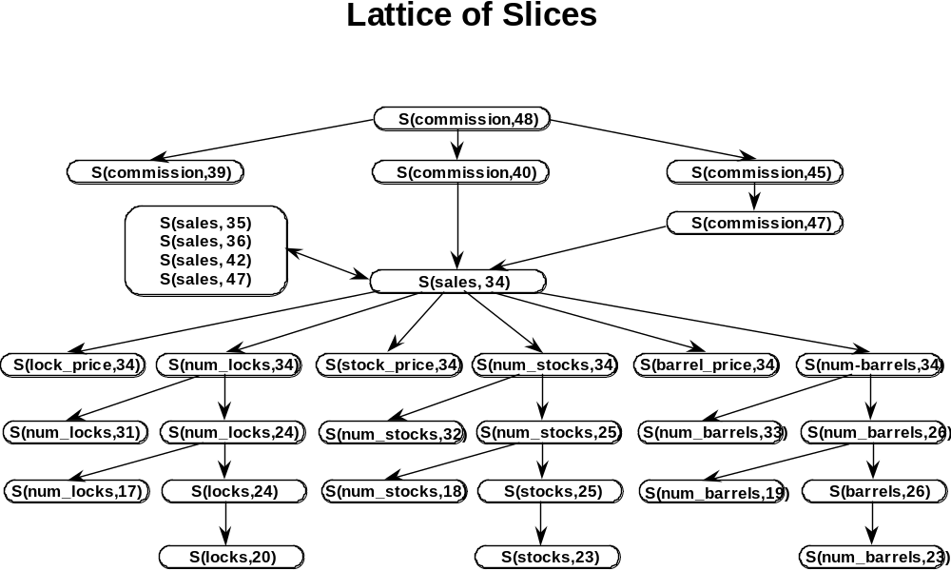

Slide 35
